Slide 1
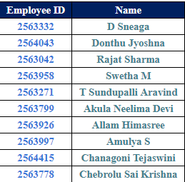
Online Movie ticket booking-Microservices
230 Java SL KK batch : Group number – 02
Group details:

Slide 2
Table of contents
Project objective
Technology stack
Database Schema
Microservices
Admin service
User service
Movie service
Booking service
Cart service
Consumers
Admin registration & login
Manage users
Manage movies
User login & registration
Update user
Search and sort movies
List of enabled movies
Add to cart
Manage bookings
Customize cart

Slide 3
1.Project objective
Identify and create microservices that are present in the application of online movie ticket booking and create different consumers of these microservices using Spring cloud, eureka server , feign , resilience4j and zipkin , sleuth for monitoring

Slide 4
2.Technology stack
Server-side: Spring Boot, Spring Cloud, Spring Data JPA
Database: MySQL
Server: Embedded Tomcat
DevOps: Docker, Git Hub
Spring Cloud: Spring Cloud config, spring cloud Netflix Eureka, Feign, Resilience4j, Retry, Sleuth and Zipkin

Slide 5
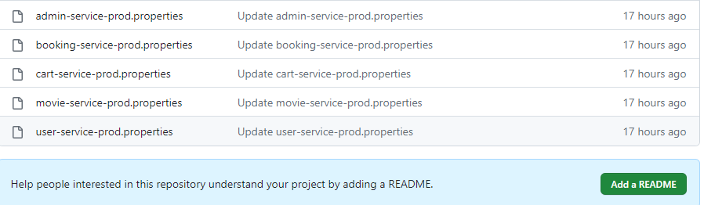
Spring cloud
Spring cloud config:
Spring Cloud Config is Spring’s client/server approach for storing and serving distributed configurations across multiple applications and environments.

Slide 6
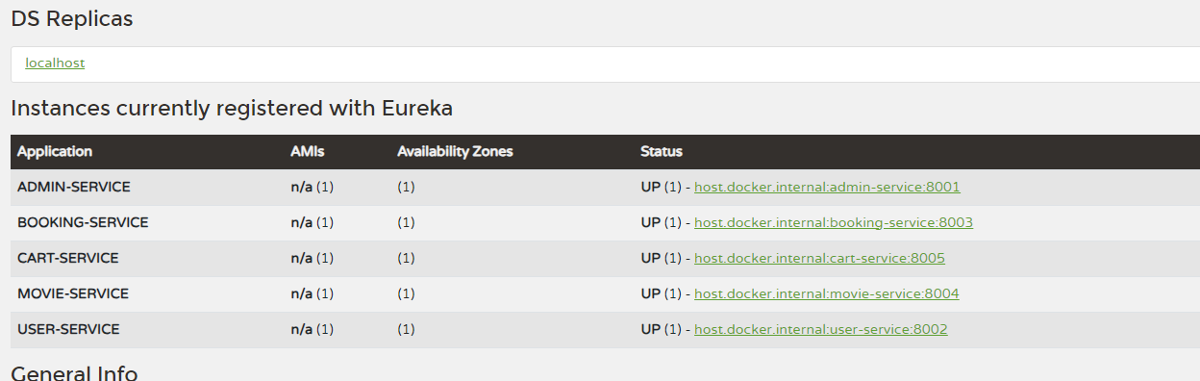
Spring Cloud – Netflix Eureka
Eureka is the Netflix Service Discovery Server and Client. The server can be configured and deployed to be highly functional, with each server copying the state of the registered services to the others. With Netflix Eureka, every client can simultaneously act as a server to replicate its status to a connected peer

Slide 7
Spring feign
Declarative API Requests: Feign simplifies HTTP requests by defining them as Java interfaces with annotated methods.
Integration with Service Discovery: Feign can seamlessly integrate with service discovery tools like Eureka or Consul.
Load Balancing: It works with load balancing solutions (e.g., Ribbon) to evenly distribute requests among service instances.
Fallback and Error Handling: Feign provides mechanisms for handling errors and defining fallback methods for graceful degradation in case of service failures.

Slide 8
Resilience 4J
Resilience4j is a lightweight fault tolerance library that provides a variety of fault tolerance and stability patterns to a web application.
Resilience4j provides higher-order functions (decorators) to enhance any functional interface, lambda expression or method reference with a Circuit Breaker, Rate Limiter, Retry or Bulkhead.
With Resilience4j you don't have to go all-in, you can pick what you need.
Resilience4j provides several core modules and add-on modules

Slide 9
Retry
Automated Retry: Resilience4j's Retry module automates retries for handling transient failures in microservices.
Declarative or Programmatic: Retry behavior can be configured declaratively with annotations or programmatically in code.
Exponential Backoff: It supports strategies like exponential backoff to reduce the load on failing services.
Customizable Control: Highly customizable with options for defining retry count, intervals, and conditions for precise control over retry logic in microservices.

Slide 10
Sleuth
Distributed Tracing: Sleuth is a Java library for distributed tracing that helps monitor and analyze requests as they traverse through microservices.
Integration with Spring Cloud: It seamlessly integrates with Spring Cloud, making it easy to implement distributed tracing in Spring Boot-based microservices.
Unique Trace IDs: Sleuth generates and propagates unique trace and span IDs, allowing you to trace requests across multiple microservices and gather insights into performance bottlenecks.
Visualization and Analysis: The collected trace data can be visualized and analyzed with tools like Zipkin or Jaeger, helping you troubleshoot issues and optimize microservices' performance.

Slide 11
Zipkin
Distributed Tracing Tool: Zipkin is an open-source distributed tracing system that helps monitor and troubleshoot microservices-based applications.
Trace Collection and Visualization: Zipkin collects trace data generated by services and provides a visual representation of request flow, helping developers identify performance bottlenecks.
Integration with Other Tools: Zipkin can integrate with other observability and monitoring tools, allowing you to correlate trace data with metrics and logs for comprehensive insights into your microservices ecosystem.

Slide 12
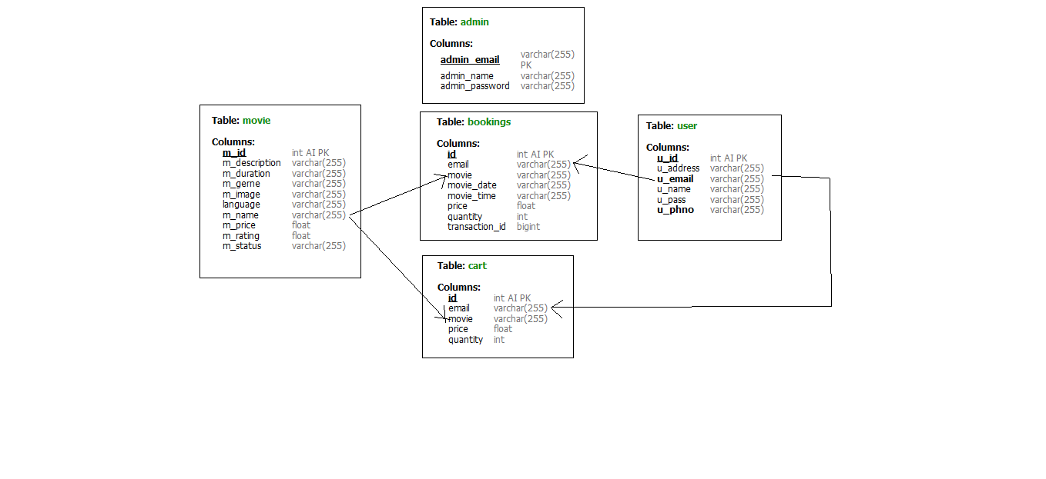
3.DataBase schema

Slide 13
4.1 Admin service
Api end points of admin
http://localhost:8001/admin - post mapping – adding admin details
http://localhost:8001/admin/{emai} – get mapping – get admin details by email

Slide 14
4.2 User service
Api end points of user service
http://localhost:8002/user - post mapping - add user details
http://localhost:8002/userByEmail/{email} – get mapping – get user details by email
http://localhost:8002/users - get mapping – get all user details
http://localhost:8002/updateUser - put mapping - update user details
http://localhost:8002/user/{id} – delete mapping – delete user by id

Slide 15
4.3 Movie service
Api end points of movie service
http://localhost:8004/addMovie - post mapping - add new movie
http://localhost:8004/movies - get mapping - get all movies list
http://localhost:8004/movie/{id} – get mapping - get movie details by id
http://localhost:8004/getEnabledMovies - get mapping - get movies that are enabled by admin
http://localhost:8004/sortMoviesByGerne - get mapping - get all movies list sorted by genre
http://localhost:8004/searchMovie/{movie} – get mapping – get all movies by movie name,genre,language
http://localhost:8004/updateMovie - put mapping - update movie details
http://localhost:8004/deleteMovieById/{id} – delete mapping – delete movie by id

Slide 16
4.4 booking service
Api end points of booing service
http://localhost:8003/order - post mapping - add new booking
http://localhost:8003/order/{email} – get mapping – get order details by user email
http://localhost:8003/order/{email} – delete mapping – delete all booking by a user

Slide 17
4.5 Cart service
Api end points of cart service
http://localhost:8005/cart - post mapping - add cart details
http://localhost:8005/cart - put mapping - update cart details
http://localhost:8005/cart/id/{id} – delete mapping - delete cart by id
http://localhost:8005/cart/email/{email} – delete cart details by user email

Slide 18
Consumers for UI(online movie ticket booking)
Consumers
Admin registration & login
Manage users
Manage movies
User login & registration
Update user
Search and sort movies
List of enabled movies
Add to cart
Manage bookings
Customize cart
For all these consumers feign,resilience4j,zinkin & sleuth is implemented as different consumers by adding compatibilities of circuit breakers & retry events

Slide 19

Queries ?

Slide 20

Thank you

